Slide 1
Low Power System Design (PVL 207)

Slide 2
Supply Voltage Scaling Approaches
Static Voltage Scaling
Multi-level Voltage Scaling
Dynamic Voltage and Frequency Scaling
Adaptive Voltage Scaling

Slide 3
Important Observations:
The workload of a CPU is a time varying function, which heavily depends on the application.
The energy drawn from the power supply is the integration of the power over time.
CMOS circuits can operate over a voltage range with reasonable reliability.
There is a region of operation where frequency increases monotonically over voltage.

Slide 4
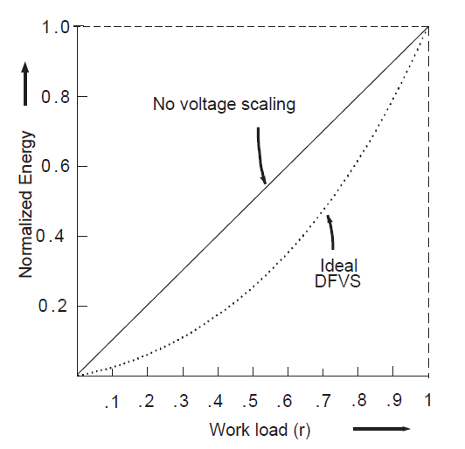
Dynamic frequency scaling (DFS)
P = C.Vdd².f
Energy drawn from the power supply can be reduced dynamically
adjusting the clock speed that meets the workload conditions

Slide 5
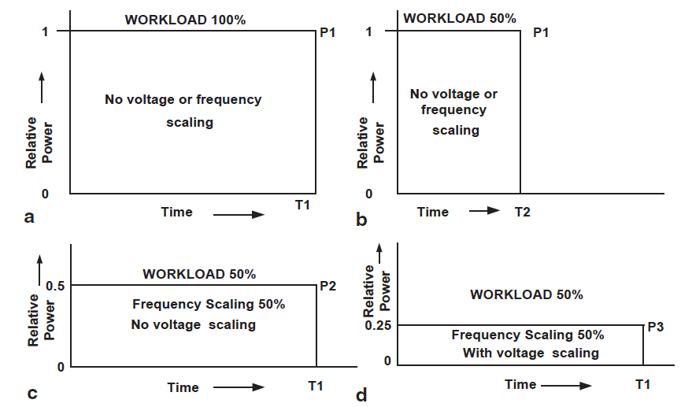
DFS Vs DVFS
Four different cases with two different workloads and with voltage and frequency scaling

Slide 6
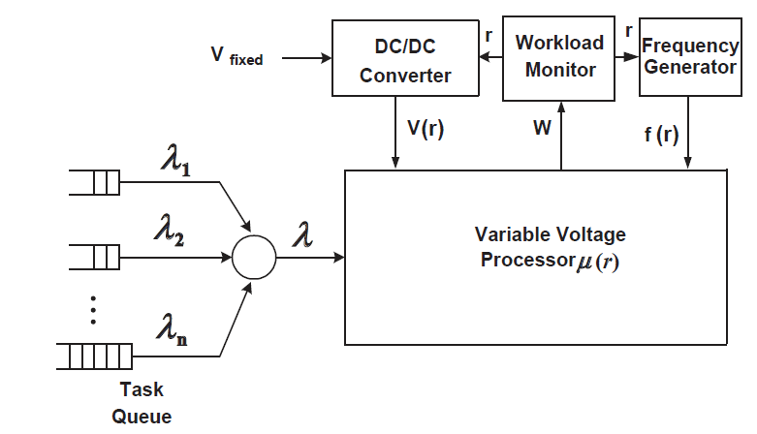
The model of the DVFS System
Workload for the next observation interval can be predicted by the OS kernel based on
the workload statistics of the previous N intervals

Slide 7
Implementation requirements in DVFS
Hardware/Software requirements for DVFS implementation:
Variable voltage processor μ( r)
Variable voltage generator V( r)
Variable frequency generator f( r)
Workload predictor

Slide 8
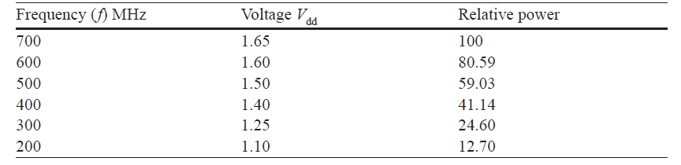
Variable voltage processor u(r)
Strong ARM 1100 allows voltage scaling
Relationship between voltage, frequency and power

Slide 9
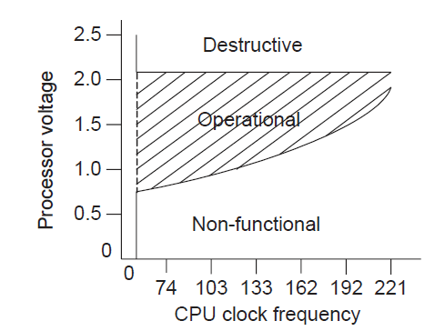
Transmeta’s crusoe processor allows the following adjustments:
Frequency change in steps of 33 MHz
Voltage change in steps of 25mV
Up to 200 Frequency/Voltage changes per second.

Slide 10
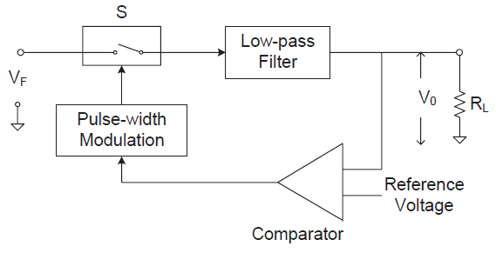
Variable voltage generator V(r)
DC to DC converter receives a fixed voltage VF and generates a variable voltage V(r) based on the input reference voltage from the workload monitoring system.

Slide 11
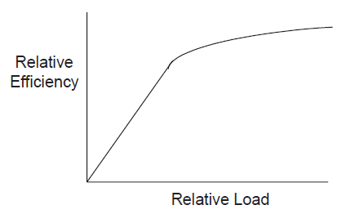
DC to DC Converter
It is possible to realize DC-to-DC converters having high efficiency, say 90% and above.
However, the efficiency drops off as the load decreases
Efficiency Versus Load

Slide 12
Variable Frequency Generator f(r)
The heart of the device is the high performance PLL core, consisting of a Phase
Frequency Detector (PFD), Programmable on chip filter, and VCO
The PLL generates a high speed clock
The output of the PLL drives a frequency divider
The divider generates the variable frequency f (r)
The PLL and the divider together generates the independent frequencies related
to the PLL operating frequency

Slide 13
Workload Prediction
An adaptive approach for workload prediction by filtering the trace history
Workload for the next observation interval can be predicted based on the workload statistics of the previous N intervals
Nth order Markov process
hn [K] represents an N-tap , adaptable FIR filter.
Moving average workload (MAW): hn[k] = 1/N
Exponential Weighted Averaging (EWA) : hn[k] = a^{-k}
Least Mean Square[LMS]: hn+1[k] = hn[k]+u We[n]. W (n-k) where We [n] = W[n]-Wp[n] , u is the step size
Ref: Amit Sinha and A. Chandrakasan

Slide 14
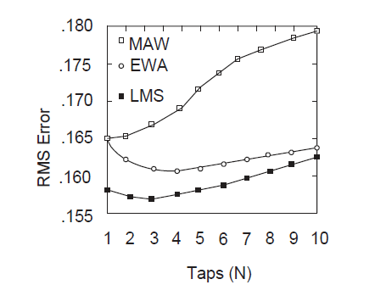
Prediction performance of Different Filters

Slide 15
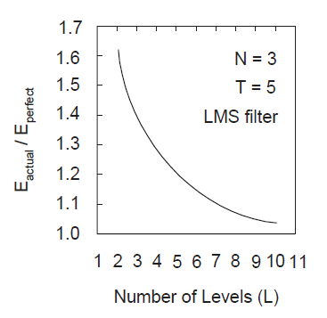
Discrete processing rate
Too few operating points may result in ramping between two levels for workload
profiles and too many levels may result in hunting of the power supply for a new
Supply voltage most of the time.
For L = 10, which is provided by all practical processors the ESR degradation due to
quantization noise is less than 10%.

Slide 16
Latency Overhead
There is a latency overhead involved in processing rate update.
This is due to the finite feedback bandwidth associated with the PLL and the DC-to-DC converter.
Switching to higher processing rate:
The voltage should be increased first followed by the increase in frequency and the following steps to be followed:
Set the new voltage
Allow the new voltage to settle down.
Set the new frequency
Switching to lower processing Rate
Set the new frequency
Set the new voltage. The CPU continues operating at the new frequency while voltage settles to the new value

Slide 17
Adaptive Voltage Scaling

Slide 18
Adaptive Voltage Scaling
The voltage scaling techniques discussed so far are open-loop in nature. Voltage - frequency pairs are determined at design time keeping sufficient margin for guaranteed operation across the entire range of best and worst case process, voltage and temperature (PVT) conditions.
As the design needs to be very conservative for successful operation, the actual benefit obtained is lesser than actually possible.
A better alternative that can overcome this limitation is the Adaptive Voltage Scaling (AVS) where a closed loop feedback system is implemented between the voltage scaling power supply and delay sensing performance monitor at execution time.
The on-chip monitor not only checks the actual voltage developed, but also detects whether the silicon is slow, typical or fast and the effect of temperature on the surrounding silicon

Slide 19
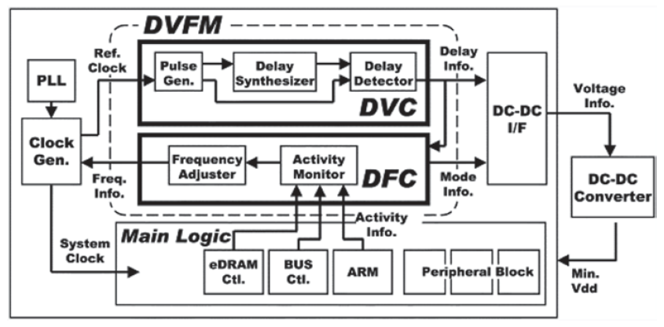
Adaptive Voltage Scaling
DVFM, Masakatsu et al, IEEE JSSC, Jan 2005

Slide 20
Adaptive Voltage Scaling
The DVC emulates the critical path characteristic of the system by using a delay synthesizer and controls the dynamic supply voltage (0.9 to 1.6 V at 5 mV step in real time)
The DFC adjusts the clock frequency at the required minimum value by monitoring the system activity (20 MHz to 120 MHz)
The voltage and frequency are predicted according to performance monitoring of the system
The DVFM system can track the required performance with a high level of accuracy over the full range of temperature and process deviations

Slide 21
Summary
Static Voltage Scaling
Device feature size scaling
Architectural Level Approaches
Parallelism
Pipelining
Multi – level voltage scaling
Macro level
Standard cell level
Dynamic Voltage and Frequency Scaling
Adaptive Voltage Scaling

Slide 22
Reference
Ajit Pal, “ Chapter 7 of Low Power VLSI Circuits and Systems” Springer 2015.

